Slide 1


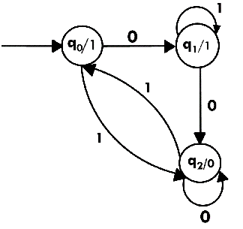


Finite State Machine(FSM) Moore m/c

Slide 2


Finite State Machine
Finite state machine is used to recognize patterns.
Finite automata machine takes the string of symbol as input and changes its state accordingly. In the input, when a desired symbol is found then the transition occurs.
While transition, the automata can either move to the next state or stay in the same state.
FA has two states: accept state or reject state. When the input string is successfully processed and the automata reached its final state then it will accept.
3

Slide 3
Finite State Machine
Definition
A Finite State Machine is a model of computation based on a hypothetical machine made of one or more states. Only one single state of this machine can be active at the same time. It means the machine has to transition from one state to another in to perform different actions.
The important points here are the following:
We have a fixed set of states that the machine can be in
The machine can only be in one state at a time
A sequence of inputs is sent to the machine
Every state has a set of transitions and every transition is associated with an input and pointing to a state
3

Slide 4
FA With output
Moore
M/C
Mealy
M/C
3

Slide 5
3

Slide 6
Q. Construct a moore machine that takes set of all strings over the input {a,b} and prints ‘1’as output for every occurrence of ‘ab’ as a substring
3

Slide 7
Q. Construct a moore machine {0,1} that produces ‘A’ as output if it ends with ‘10’ or produces output ‘B’ if ends with ‘11’ else produces ‘C’
3

Slide 8
Q. Construct a moore machine that takes binary number as input and produces residue modulo ‘3’ as output.
3

